Slide 1

Graphics for 2012 – 2015

Slide 2
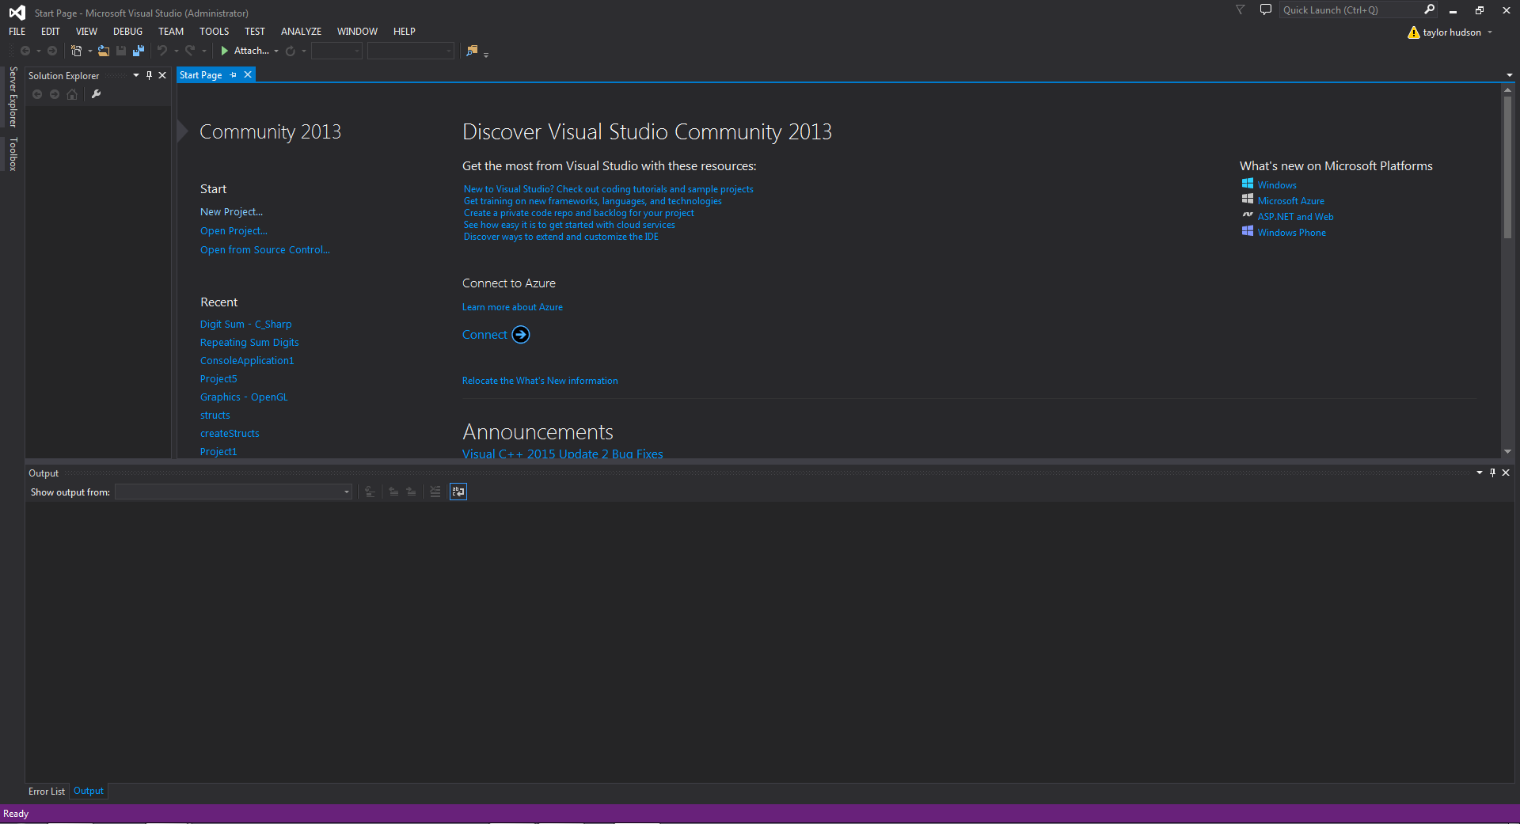
Step By Step for 2012 – 2015 Works with 2010 at home needs the alternative files
Make sure to create a new project. We are going to show how to inspect the #include <*> files. As well as show you where they are located.

Slide 3
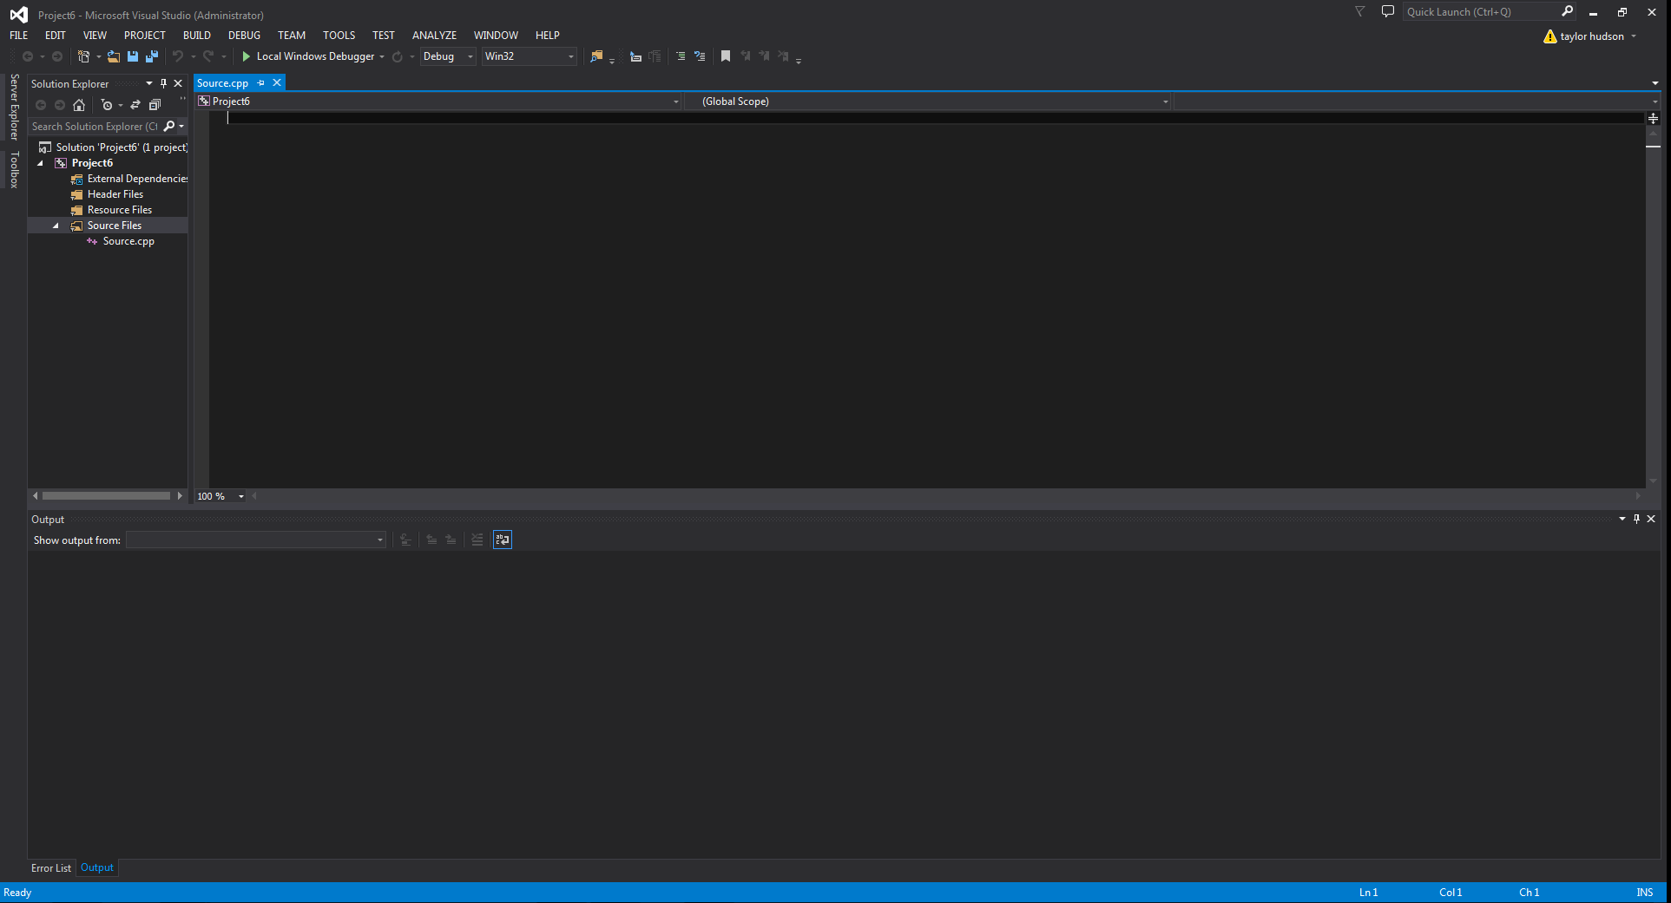
Create a *.cpp file
Pressing Ctrl + Shift + A at the same time will allow you to add a new item, add a blank *.cpp file. Include the library #include<iostream>

Slide 4
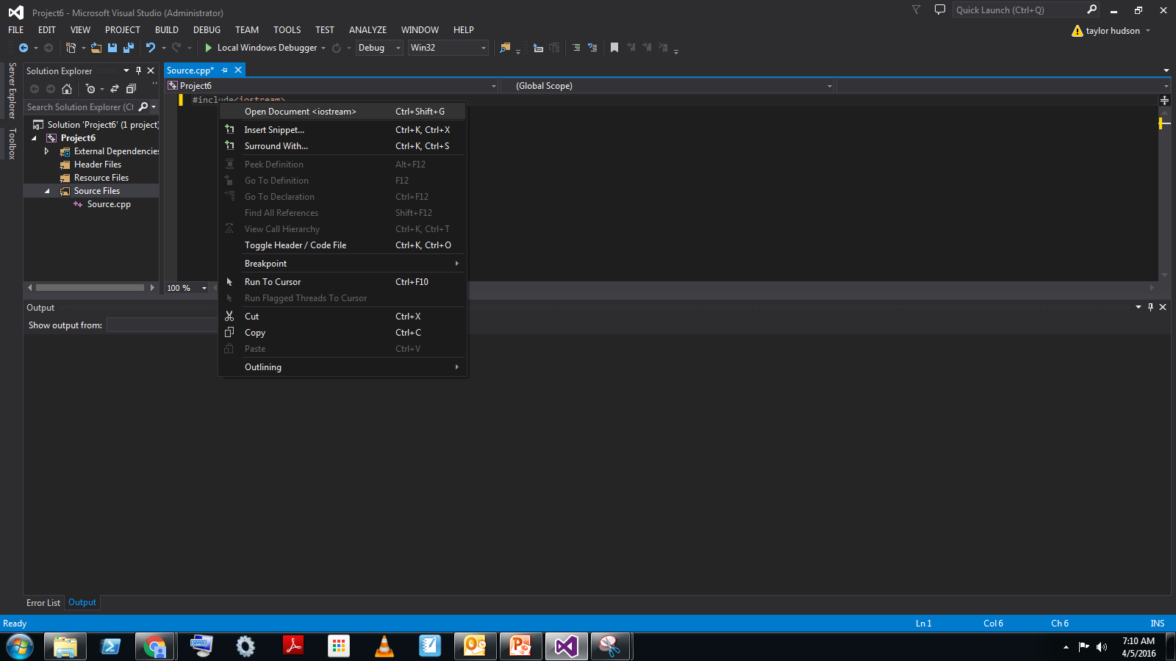
Inspect the Library Documentation
Highlight the library and either press Ctrl + Shift + G or go to the option after right clicking with the mouse to Open Document <*>

Slide 5
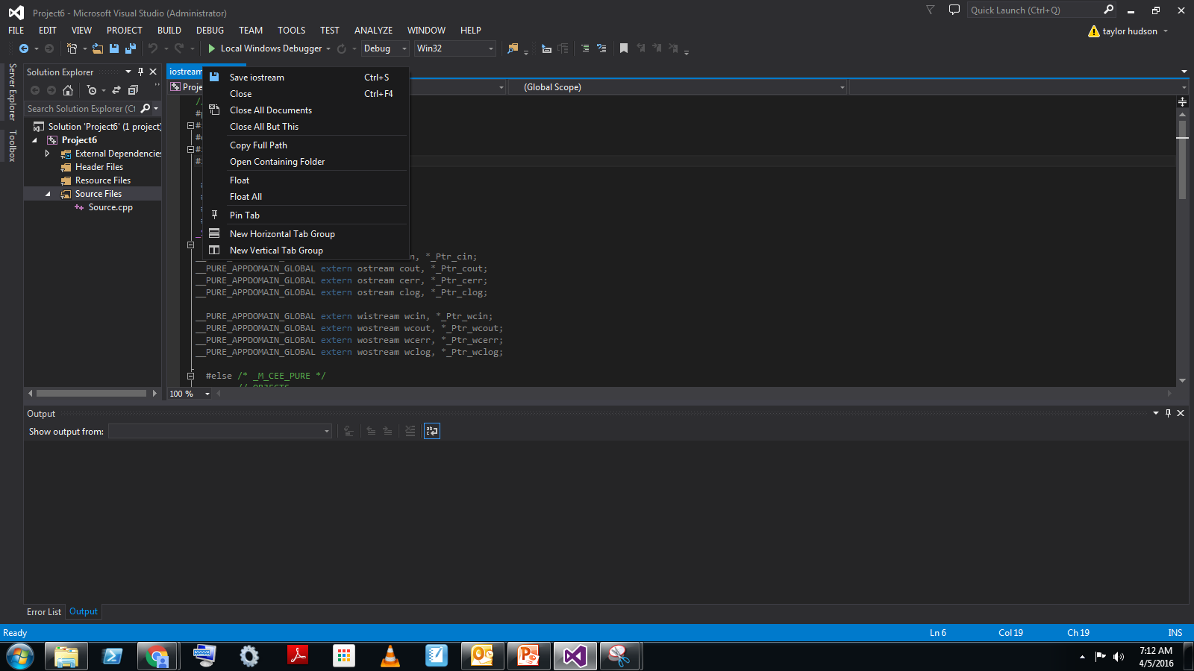
Library Code
Right click on the library tab. Select Open Containing Folder.

Slide 6
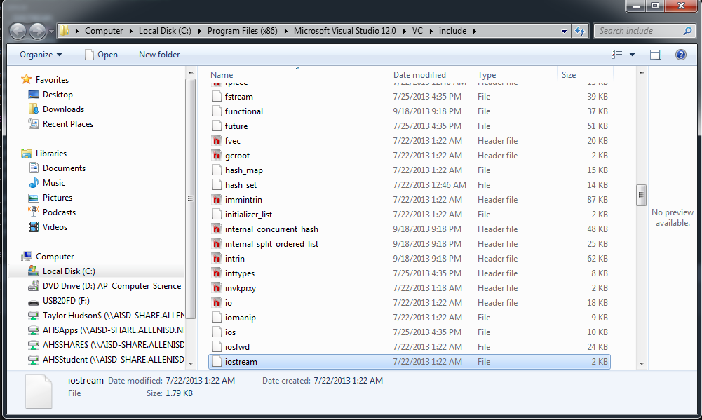
Similar but not necessarily the same pathway
Drag and Drop the modified graphics.h and winbgi.cpp files into this folder. If they already exist then someone has already added them.

